Slide 1


Instruction Level Parallelism and Superscalar Processors
William Stallings Computer Organization and Architecture 8th Edition

Slide 2
What is Superscalar?
Common instructions (arithmetic, load/store, conditional branch) can be initiated and executed independently
Equally applicable to RISC & CISC
In practice usually RISC

Slide 3
Why Superscalar?
Most operations are on scalar quantities (see RISC notes)
Improve these operations to get an overall improvement

Slide 4
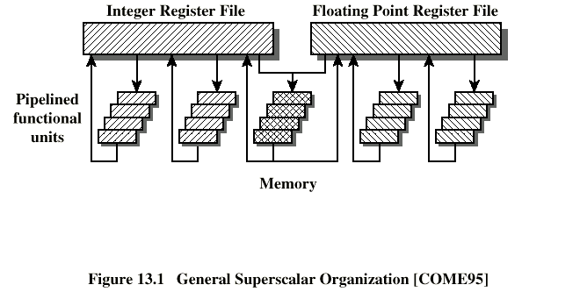
General Superscalar Organization

Slide 5
Superpipelined
Many pipeline stages need less than half a clock cycle
Double internal clock speed gets two tasks per external clock cycle
Superscalar allows parallel fetch execute

Slide 6
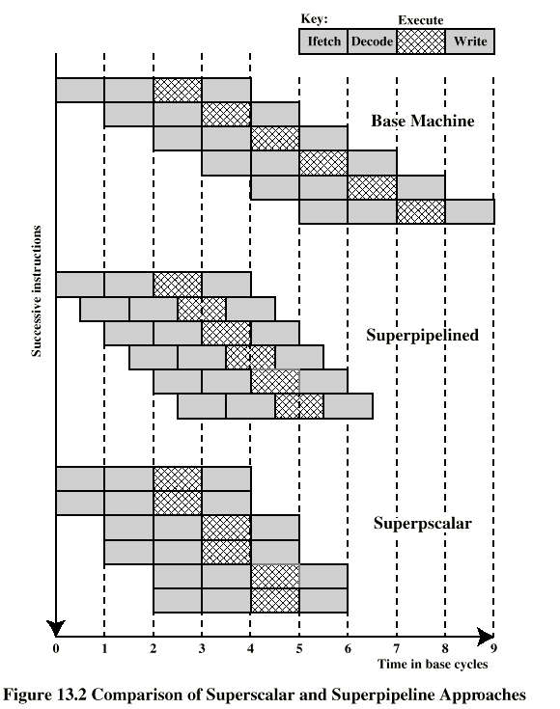
Superscalar v Superpipeline

Slide 7
Limitations
Instruction level parallelism
Compiler based optimisation
Hardware techniques
Limited by
True data dependency
Procedural dependency
Resource conflicts
Output dependency
Antidependency

Slide 8
True Data Dependency
ADD r1, r2 (r1 := r1+r2;)
MOVE r3,r1 (r3 := r1;)
Can fetch and decode second instruction in parallel with first
Can NOT execute second instruction until first is finished

Slide 9
Procedural Dependency
Can not execute instructions after a branch in parallel with instructions before a branch
Also, if instruction length is not fixed, instructions have to be decoded to find out how many fetches are needed
This prevents simultaneous fetches

Slide 10
Resource Conflict
Two or more instructions requiring access to the same resource at the same time
e.g. two arithmetic instructions
Can duplicate resources
e.g. have two arithmetic units

Slide 11
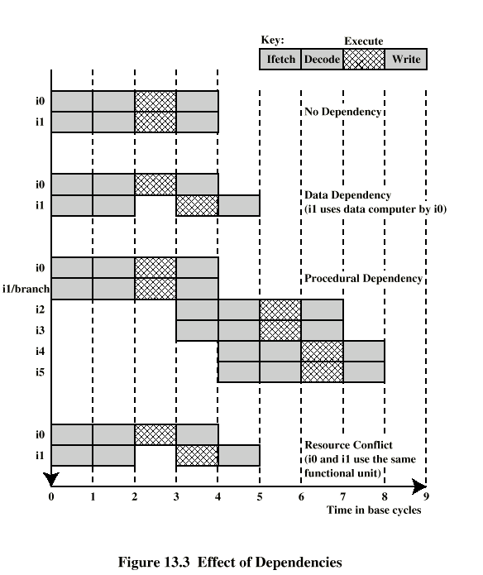
Effect of Dependencies

Slide 12
Design Issues
Instruction level parallelism
Instructions in a sequence are independent
Execution can be overlapped
Governed by data and procedural dependency
Machine Parallelism
Ability to take advantage of instruction level parallelism
Governed by number of parallel pipelines

Slide 13
Instruction Issue Policy
Order in which instructions are fetched
Order in which instructions are executed
Order in which instructions change registers and memory

Slide 14
In-Order Issue In-Order Completion
Issue instructions in the order they occur
Not very efficient
May fetch >1 instruction
Instructions must stall if necessary

Slide 15
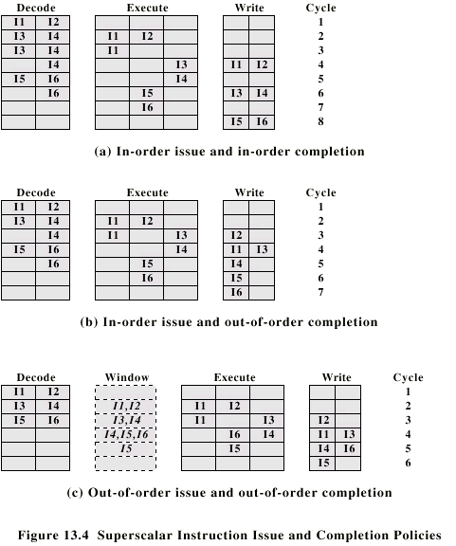
In-Order Issue In-Order Completion (Diagram)

Slide 16

In-Order Issue Out-of-Order Completion
Output dependency
R3:= R3 + R5; (I1)
R4:= R3 + 1; (I2)
R3:= R5 + 1; (I3)
I2 depends on result of I1 - data dependency
If I3 completes before I1, the result from I1 will be wrong - output (read-write) dependency

Slide 17

In-Order Issue Out-of-Order Completion (Diagram)

Slide 18
Out-of-Order Issue Out-of-Order Completion
Decouple decode pipeline from execution pipeline
Can continue to fetch and decode until this pipeline is full
When a functional unit becomes available an instruction can be executed
Since instructions have been decoded, processor can look ahead

Slide 19

Out-of-Order Issue Out-of-Order Completion (Diagram)

Slide 20
Antidependency
Write-write dependency
R3:=R3 + R5; (I1)
R4:=R3 + 1; (I2)
R3:=R5 + 1; (I3)
R7:=R3 + R4; (I4)
I3 can not complete before I2 starts as I2 needs a value in R3 and I3 changes R3

Slide 21
Register Renaming
Output and antidependencies occur because register contents may not reflect the correct ordering from the program
May result in a pipeline stall
Registers allocated dynamically
i.e. registers are not specifically named

Slide 22
Register Renaming example
R3b:=R3a + R5a (I1)
R4b:=R3b + 1 (I2)
R3c:=R5a + 1 (I3)
R7b:=R3c + R4b (I4)
Without subscript refers to logical register in instruction
With subscript is hardware register allocated
Note R3a R3b R3c
Alternative: Scoreboarding
Bookkeeping technique
Allow instruction execution whenever not dependent on previous instructions and no structural hazards

Slide 23
Machine Parallelism
Duplication of Resources
Out of order issue
Renaming
Not worth duplication functions without register renaming
Need instruction window large enough (more than 8)

Slide 24
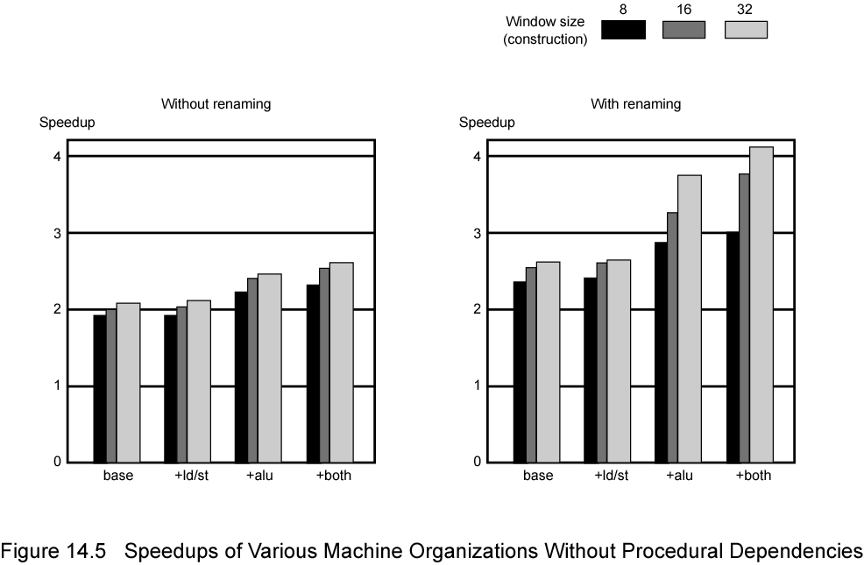
Speedups of Machine Organizations Without Procedural Dependencies

Slide 25
Branch Prediction
80486 fetches both next sequential instruction after branch and branch target instruction
Gives two cycle delay if branch taken

Slide 26
RISC - Delayed Branch
Calculate result of branch before unusable instructions pre-fetched
Always execute single instruction immediately following branch
Keeps pipeline full while fetching new instruction stream
Not as good for superscalar
Multiple instructions need to execute in delay slot
Instruction dependence problems
Revert to branch prediction

Slide 27
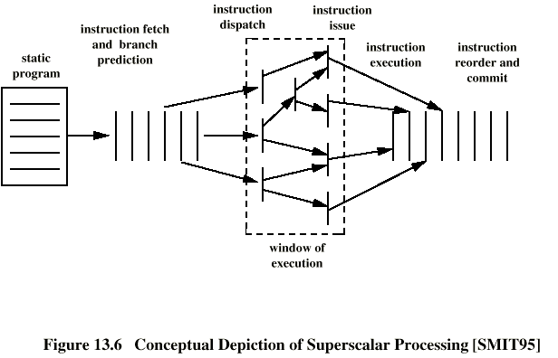
Superscalar Execution

Slide 28
Superscalar Implementation
Simultaneously fetch multiple instructions
Logic to determine true dependencies involving register values
Mechanisms to communicate these values
Mechanisms to initiate multiple instructions in parallel
Resources for parallel execution of multiple instructions
Mechanisms for committing process state in correct order

Slide 29
Pentium 4
80486 - CISC
Pentium – some superscalar components
Two separate integer execution units
Pentium Pro – Full blown superscalar
Subsequent models refine & enhance superscalar design

Slide 30
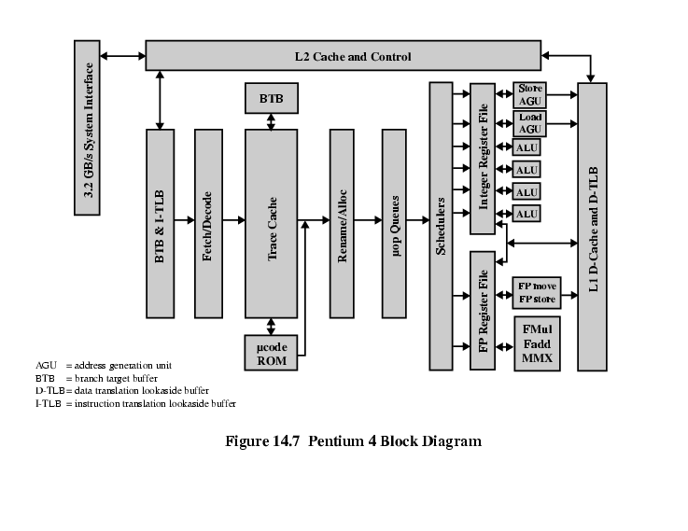
Pentium 4 Block Diagram

Slide 31
Pentium 4 Operation
Fetch instructions form memory in order of static program
Translate instruction into one or more fixed length RISC instructions (micro-operations)
Execute micro-ops on superscalar pipeline
micro-ops may be executed out of order
Commit results of micro-ops to register set in original program flow order
Outer CISC shell with inner RISC core
Inner RISC core pipeline at least 20 stages
Some micro-ops require multiple execution stages
Longer pipeline
c.f. five stage pipeline on x86 up to Pentium

Slide 32
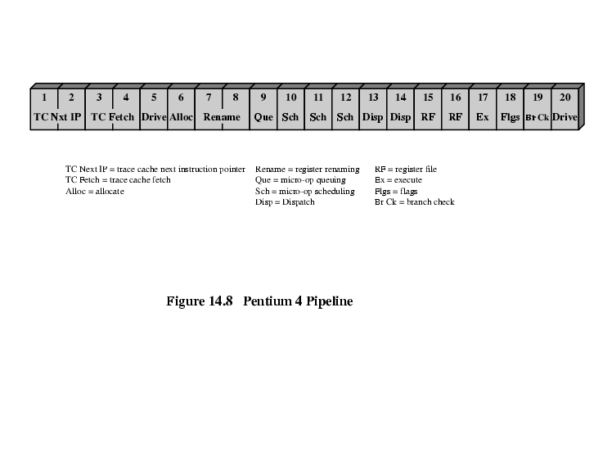
Pentium 4 Pipeline

Slide 33
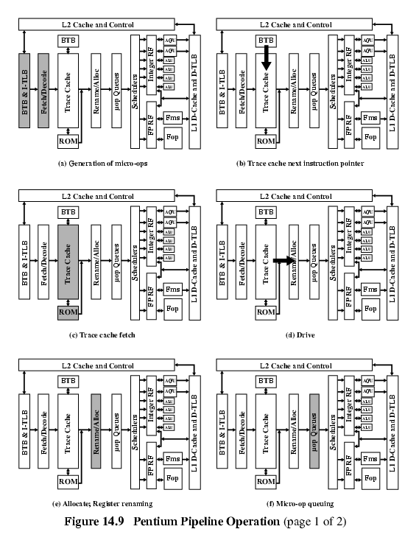
Pentium 4 Pipeline Operation (1)

Slide 34
Pentium 4 Pipeline Operation (2)

Slide 35
Pentium 4 Pipeline Operation (3)

Slide 36
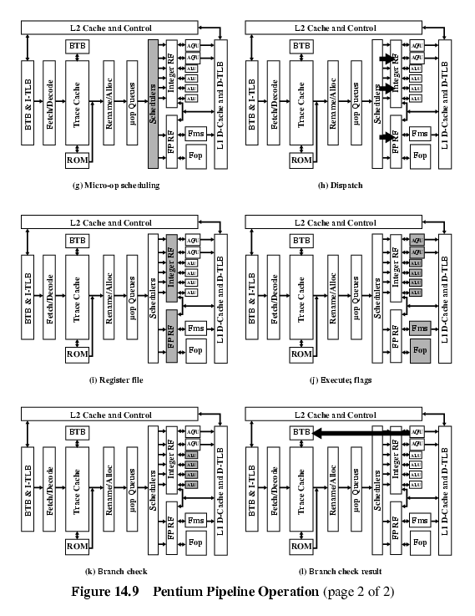
Pentium 4 Pipeline Operation (4)

Slide 37
Pentium 4 Pipeline Operation (5)

Slide 38
Pentium 4 Pipeline Operation (6)

Slide 39
ARM CORTEX-A8
ARM refers to Cortex-A8 as application processors
Embedded processor running complex operating system
Wireless, consumer and imaging applications
Mobile phones, set-top boxes, gaming consoles automotive navigation/entertainment systems
Three functional units
Dual, in-order-issue, 13-stage pipeline
Keep power required to a minimum
Out-of-order issue needs extra logic consuming extra power
Figure 14.11 shows the details of the main Cortex-A8 pipeline
Separate SIMD (single-instruction-multiple-data) unit
10-stage pipeline

Slide 40
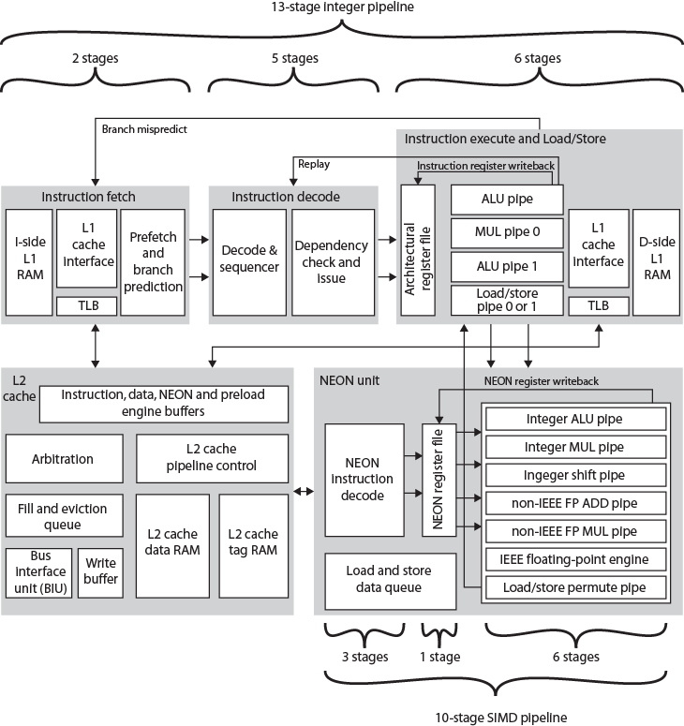

ARM Cortex-A8 Block Diagram

Slide 41
Instruction Fetch Unit
Predicts instruction stream
Fetches instructions from the L1 instruction cache
Up to four instructions per cycle
Into buffer for decode pipeline
Fetch unit includes L1 instruction cache
Speculative instruction fetches
Branch or exceptional instruction cause pipeline flush
Stages:
F0 address generation unit generates virtual address
Normally next sequentially
Can also be branch target address
F1 Used to fetch instructions from L1 instruction cache
In parallel fetch address used to access branch prediction arrays
F3 Instruction data are placed in instruction queue
If branch prediction, new target address sent to address generation unit
Two-level global history branch predictor
Branch Target Buffer (BTB) and Global History Buffer (GHB)
Return stack to predict subroutine return addresses
Can fetch and queue up to 12 instructions
Issues instructions two at a time

Slide 42
Instruction Decode Unit
Decodes and sequences all instructions
Dual pipeline structure, pipe0 and pipe1
Two instructions can progress at a time
Pipe0 contains older instruction in program order
If instruction in pipe0 cannot issue, pipe1 will not issue
Instructions progress in order
Results written back to register file at end of execution pipeline
Prevents WAR hazards
Keeps tracking of WAW hazards and recovery from flush conditions straightforward
Main concern of decode pipeline is prevention of RAW hazards

Slide 43
Instruction Processing Stages
D0 Thumb instructions decompressed and preliminary decode is performed
D1 Instruction decode is completed
D2 Write instruction to and read instructions from pending/replay queue
D3 Contains the instruction scheduling logic
Scoreboard predicts register availability using static scheduling
Hazard checking
D4 Final decode for control signals for integer execute load/store units

Slide 44
Integer Execution Unit
Two symmetric (ALU) pipelines, an address generator for load and store instructions, and multiply pipeline
Pipeline stages:
E0 Access register file
Up to six registers for two instructions
E1 Barrel shifter if needed.
E2 ALU function
E3 If needed, completes saturation arithmetic
E4 Change in control flow prioritized and processed
E5 Results written back to register file
Multiply unit instructions routed to pipe0
Performed in stages E1 through E3
Multiply accumulate operation in E4

Slide 45
Load/store pipeline
Parallel to integer pipeline
E1 Memory address generated from base and index register
E2 address applied to cache arrays
E3 load, data returned and formatted
E3 store, data are formatted and ready to be written to cache
E4 Updates L2 cache, if required
E5 Results are written to register file

Slide 46
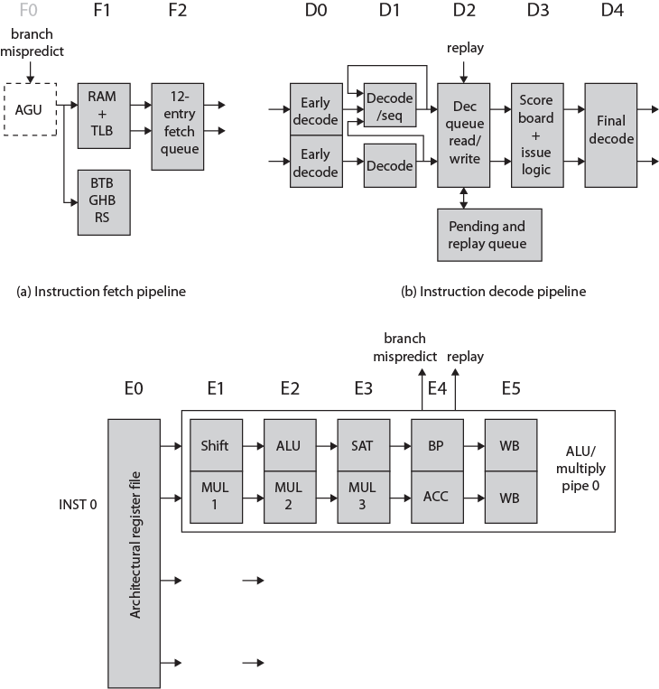
ARM Cortex-A8 Integer Pipeline

Slide 47
SIMD and Floating-Point Pipeline
SIMD and floating-point instructions pass through integer pipeline
Processed in separate 10-stage pipeline
NEON unit
Handles packed SIMD instructions
Provides two types of floating-point support
If implemented, vector floating-point (VFP) coprocessor performs IEEE 754 floating-point operations
If not, separate multiply and add pipelines implement floating-point operations

Slide 48
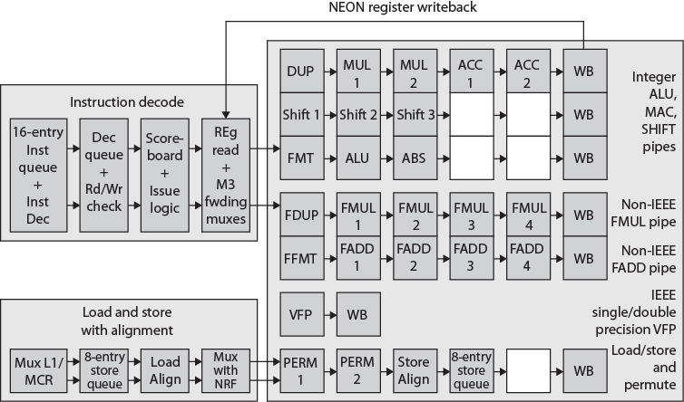
ARM Cortex-A8 NEON & Floating Point Pipeline

Slide 49
Required Reading
Stallings chapter 14
Manufacturers web sites
IMPACT web site
research on predicated execution

